Slide 1
Predicting polycystic ovary syndrome from
core body temperature measured in the vagina
Professor Tom R Gaunt
B.Sc., Ph.D.(Soton.)
Professor of Health and
Biomedical Informatics and
MRC Investigator,
Bristol Medical School (PHS)
Dr Louise A C Millard
BSc, MSc, PhD
Senior Lecturer in Health Data Science
MRC Integrative Epidemiology Unit
Bristol Medical School, University of Bristol
Dr Olalekan M Awoniran
BSc, MSc, PhD, FMSH
Senior Research Associate in Health Data Science
MRC Integrative Epidemiology Unit
Bristol Medical School, University of Bristol
Email
olalekan.awoniran@bristol.ac.uk

Slide 2






Polycystic ovary syndrome (PCOS)
Long-term health condition
Affects 8-13% of women of reproductive age
70% of PCOS cases undiagnosed
worldwide
A leading cause of infertility
AIM
To predict PCOS amongst women using BBT time series pattern analysis

Slide 3
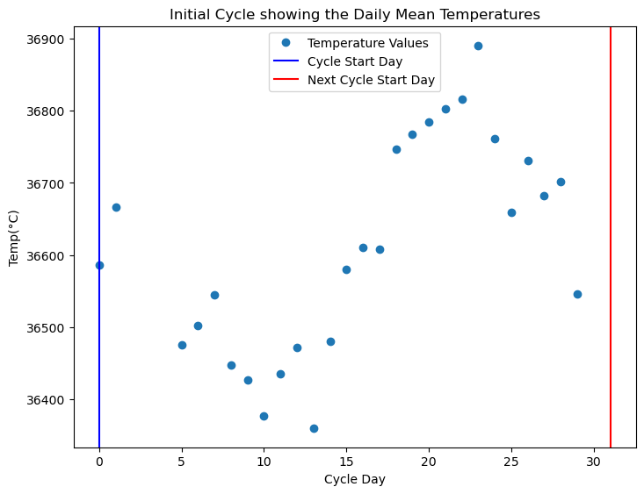
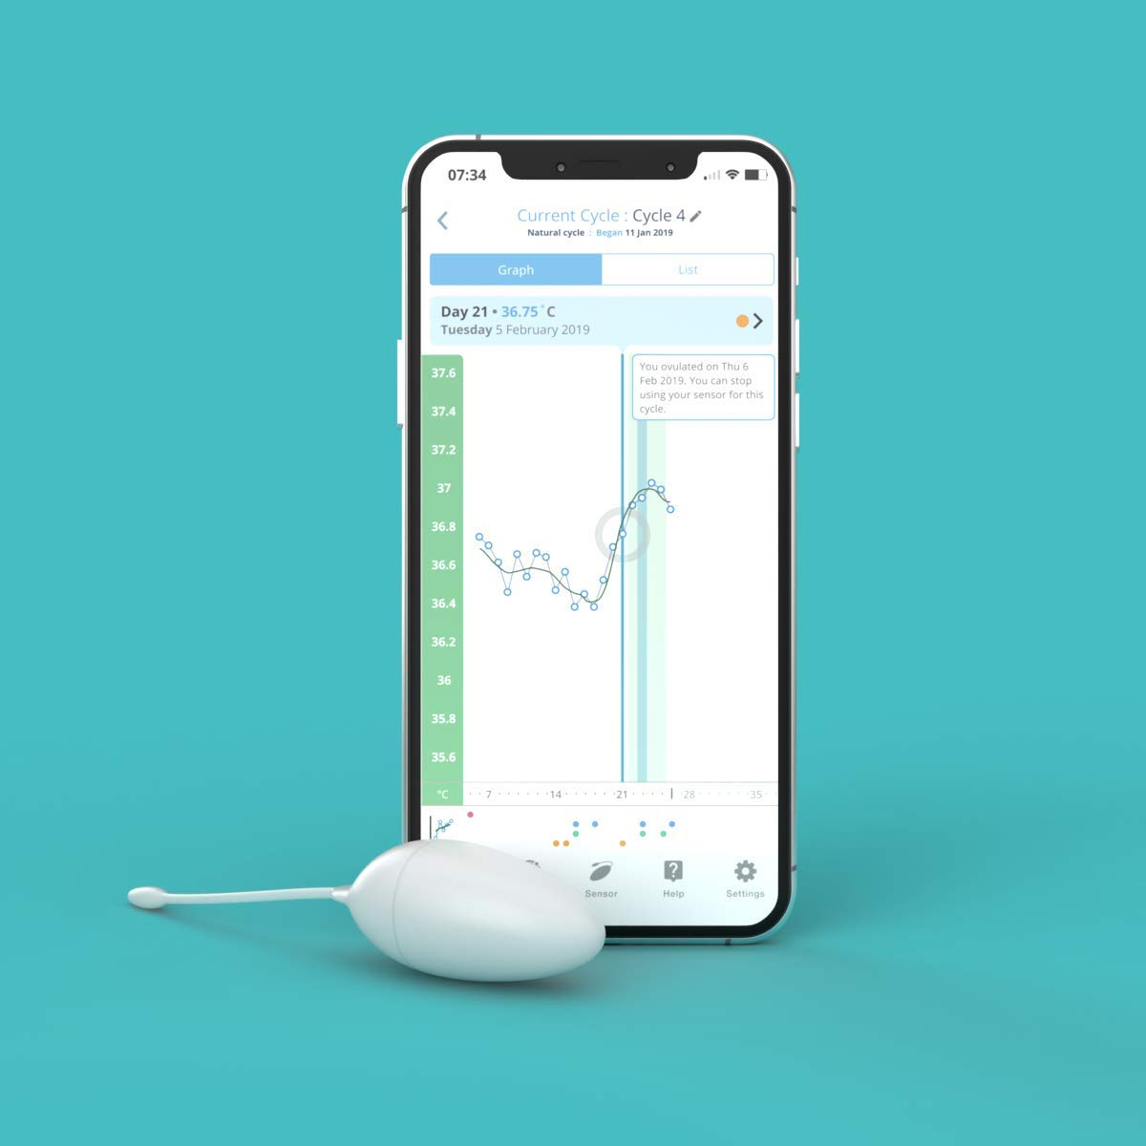
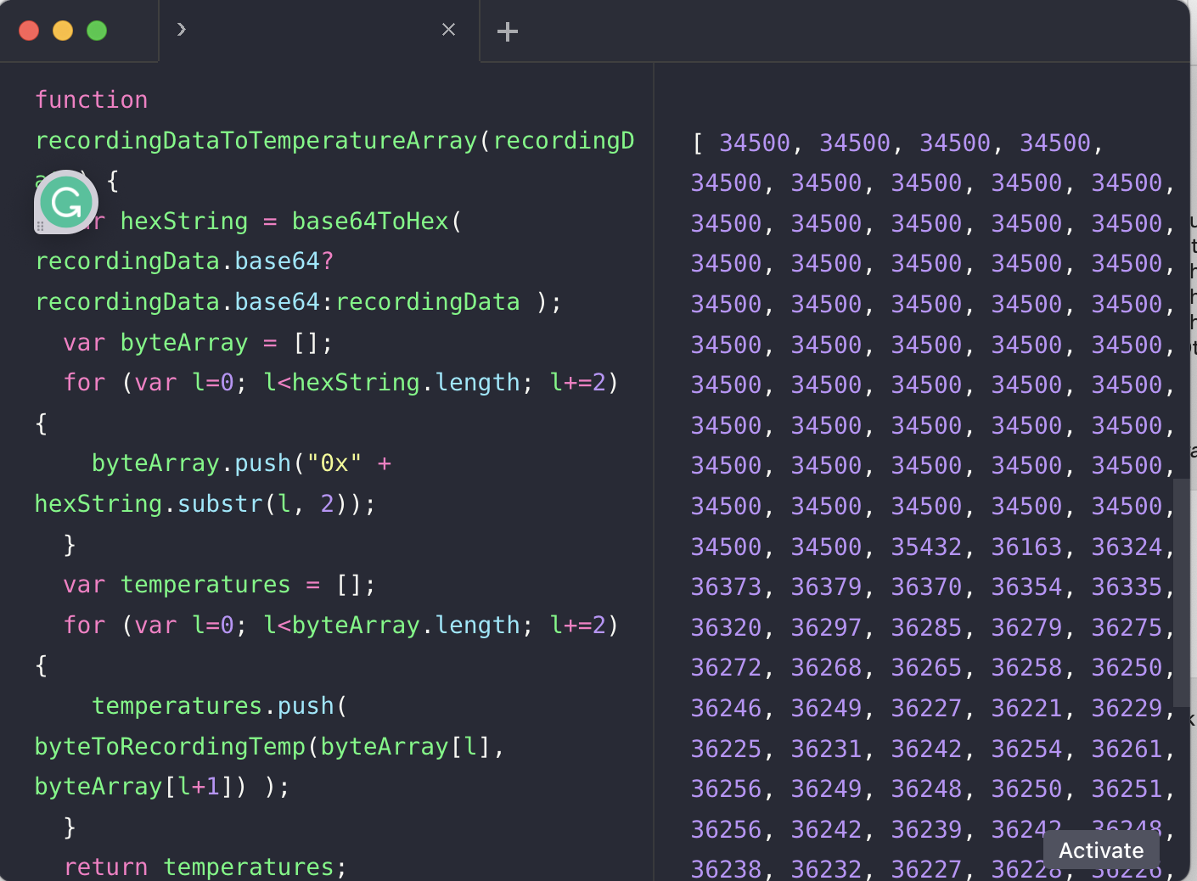



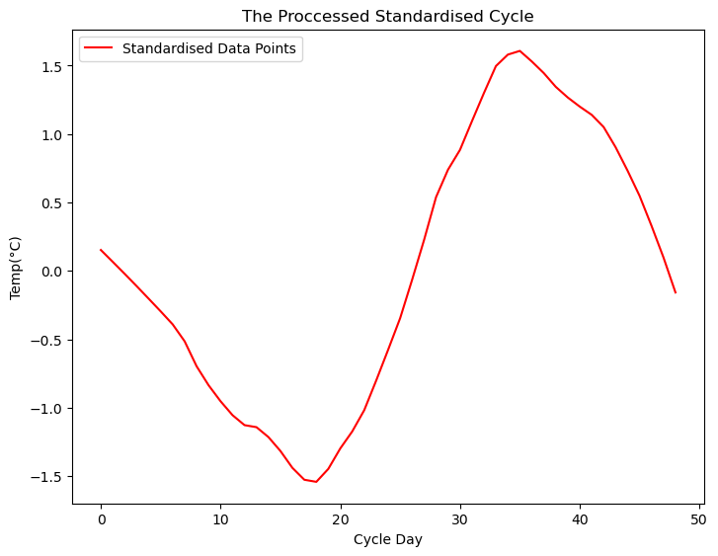

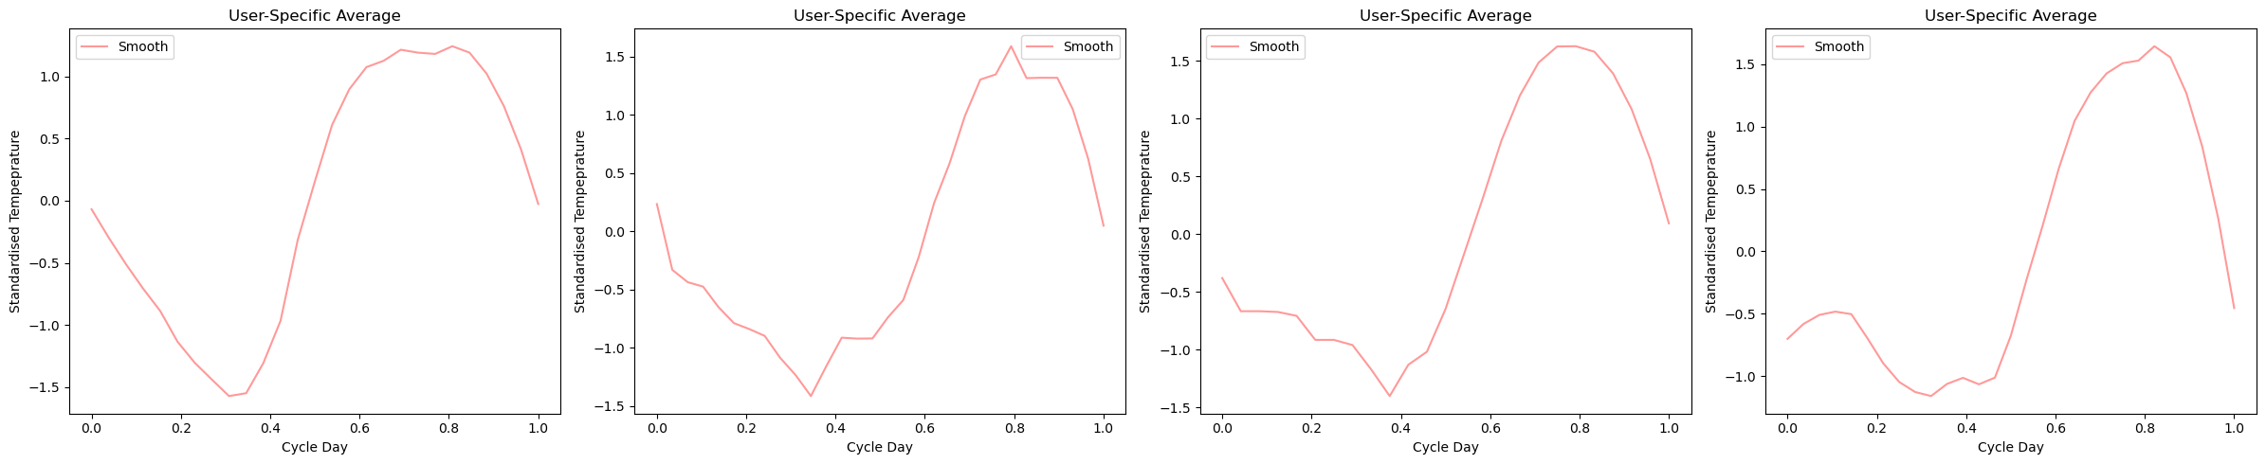
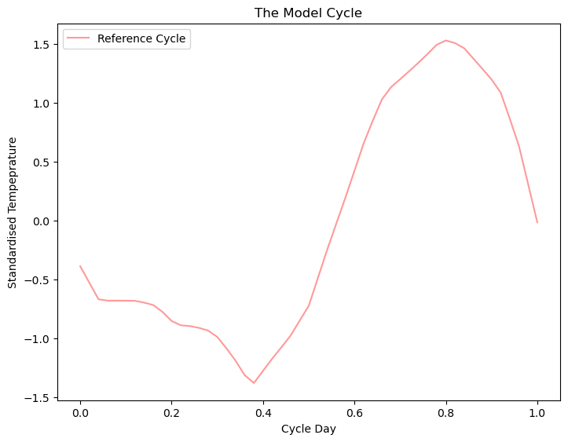
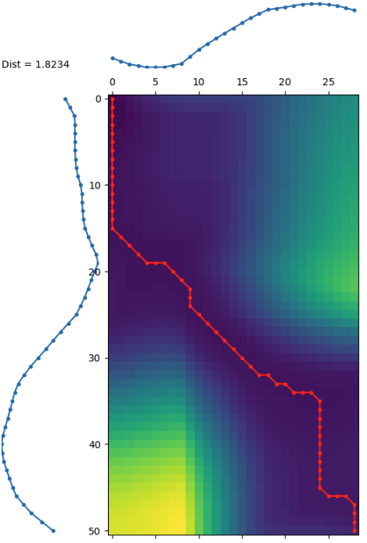
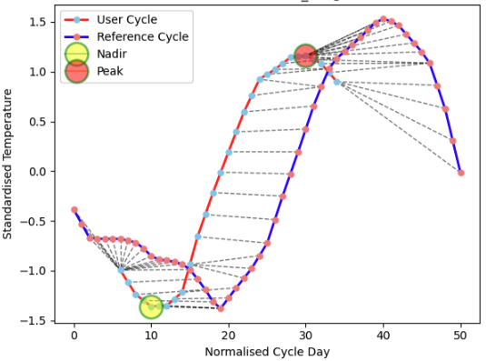
Methods
Data Cleaning
The OvuSense Device
Daily Cycle Temperatures
Data Cleaning
N = 387
N = 3754
Data Preprocessing
Daily Cycle Temperatures
Preprocessed Data
Impute Smooth Normalize Standardize
Data Preprocessing
Feature Engineering
Cycles from Four “Normal” Women
The Reference Cycle
Cycle length
Time of peak/nadir
Diff from reference
Temp of peak/nadir
Min, Max, Median and Range of Cycle Features
Change point detection
DBA Averaging
Dynamic Time Warping
Cycle-Level Features
User-Level Features
Notes:
Cycle Heterogeneity makes feature extraction difficult
Mean median and mode3 cycles were selected for each participant

Slide 4
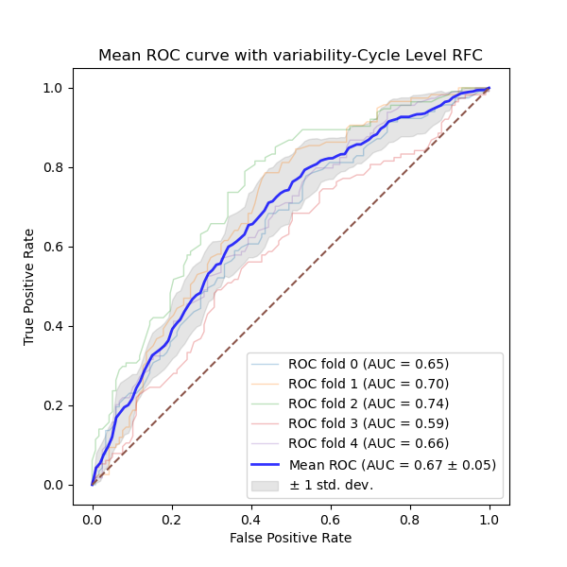
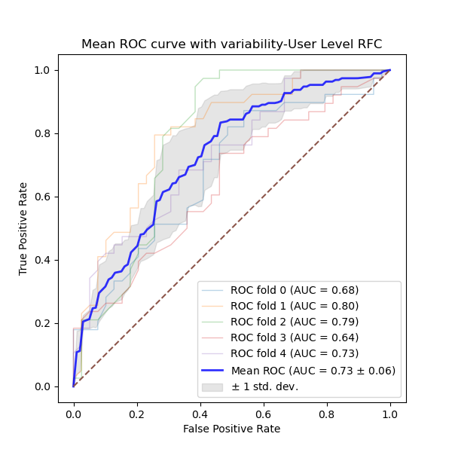
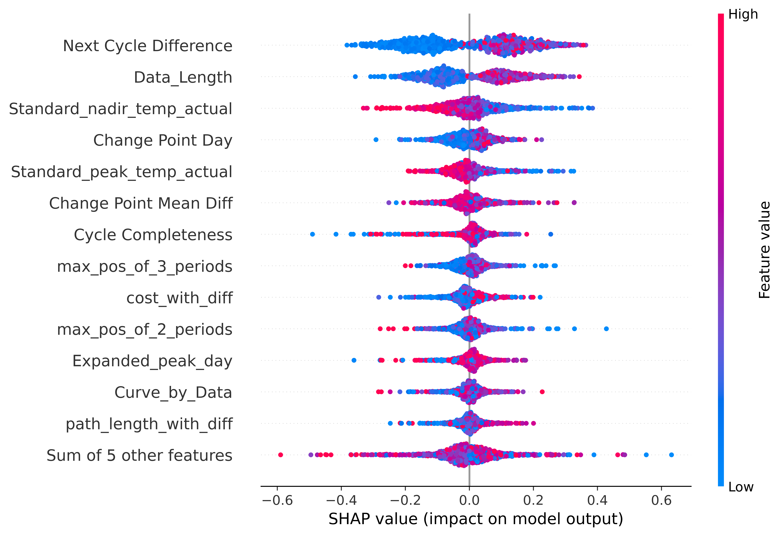
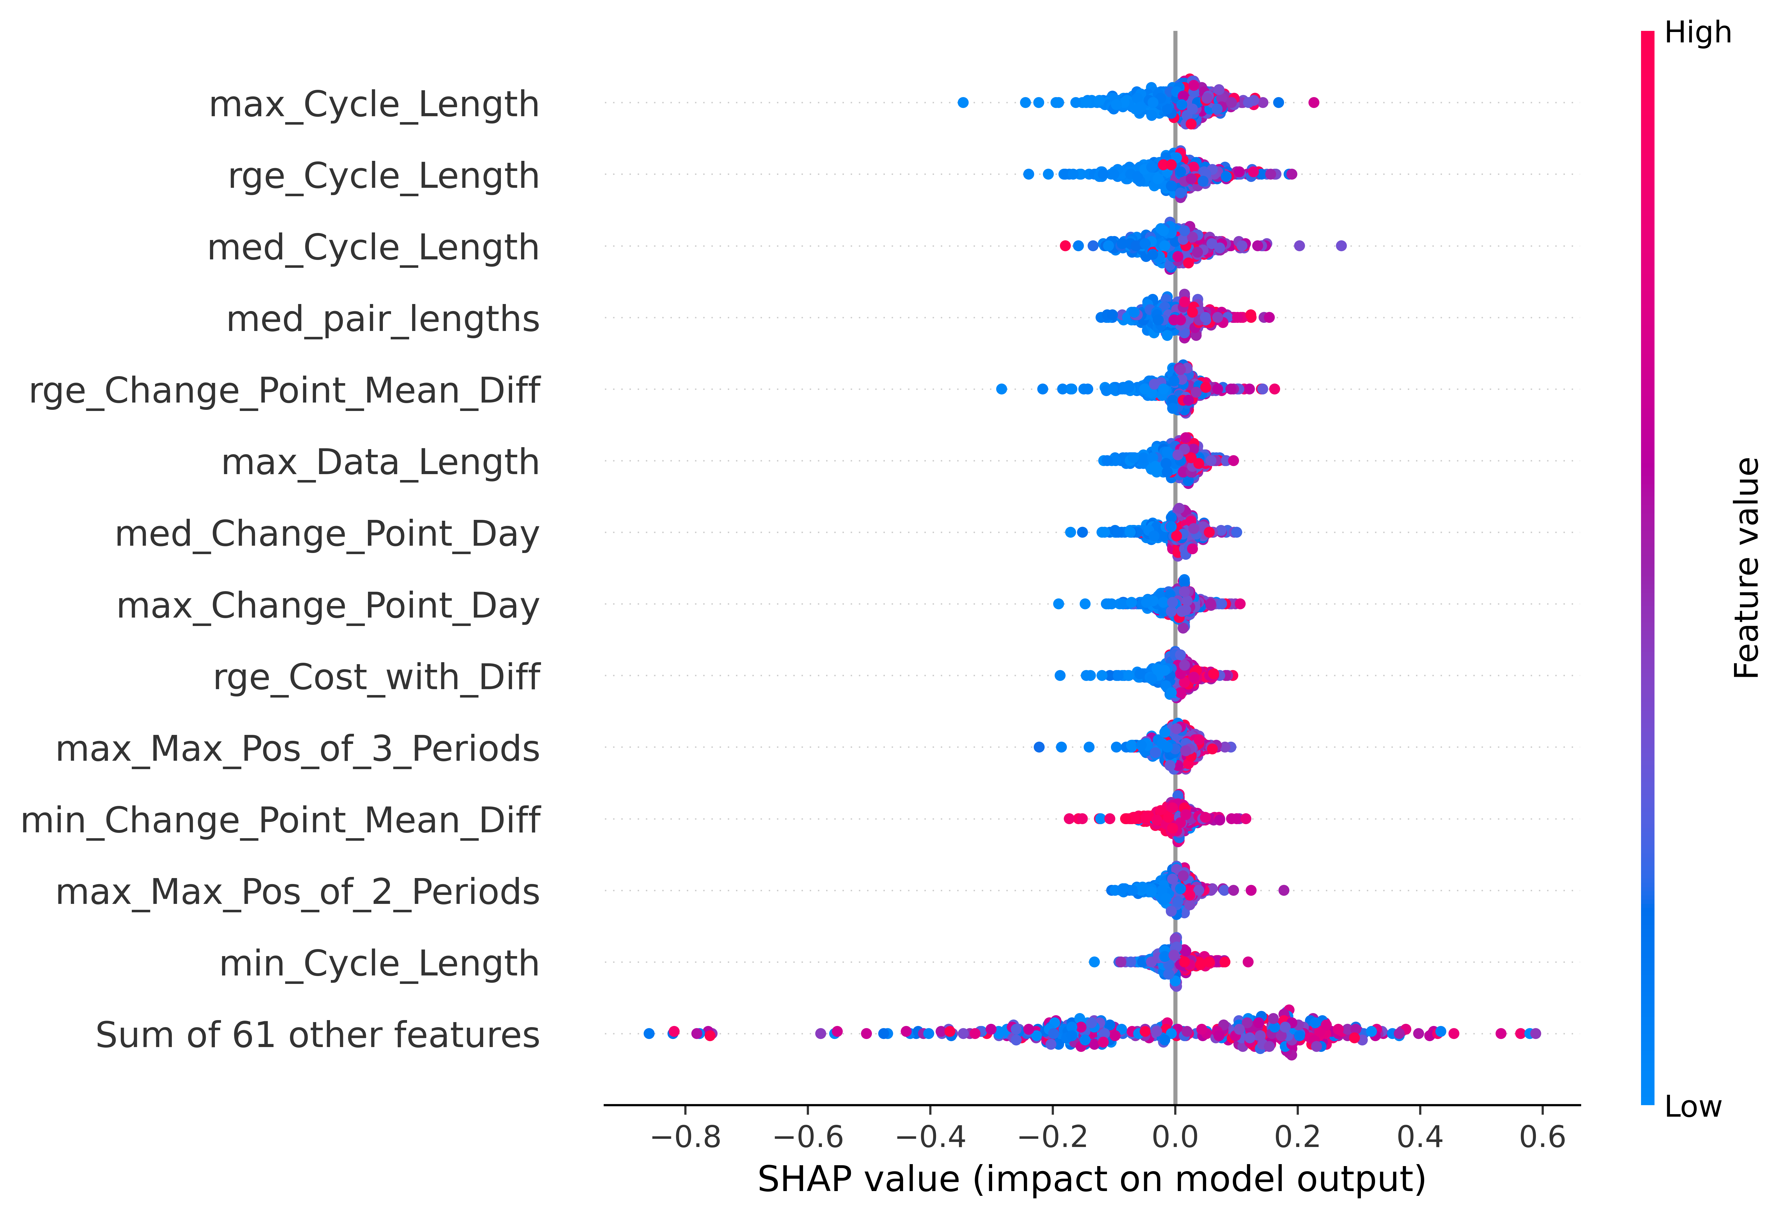
PCOS Prediction: AUC Results Comparison
Cycle Level - RFC
User Level - RFC
Model | Cycle Level | User Level
Logistic Regression (LR) | 0.65±0.07 | 0.64 ± 0.05
Support Vector Machine (SVM) | 0.66±0.07 | 0.63 ± 0.05
Random Forests Classifier (RFC) | 0.67±0.05 | 0.73±0.06

